Slide 1
Accident/Incident Investigations:
An opportunity for the Manufacturer to enhance the Product Safety.
The Airbus DS experience
MASI 2017 – San Diego (USA)
August 21st , 2017

Slide 2
CONTENTS
Airbus DS/Military Aircraft portfolio
Airbus DS P&FS organization overview
Accident/Major Incident investigation in Airbus DS
Process description
2009-2016: Incident and Accident overview
Statistics
Lessons learned and Airbus DS experience
Full involvement as Technical Advisor: Examples
Incident 27 February 16: C-295 Brazilian AF MLG collapse
Accident 31 July 15: CN-235 Colombian AF crash
Conclusions

Slide 3
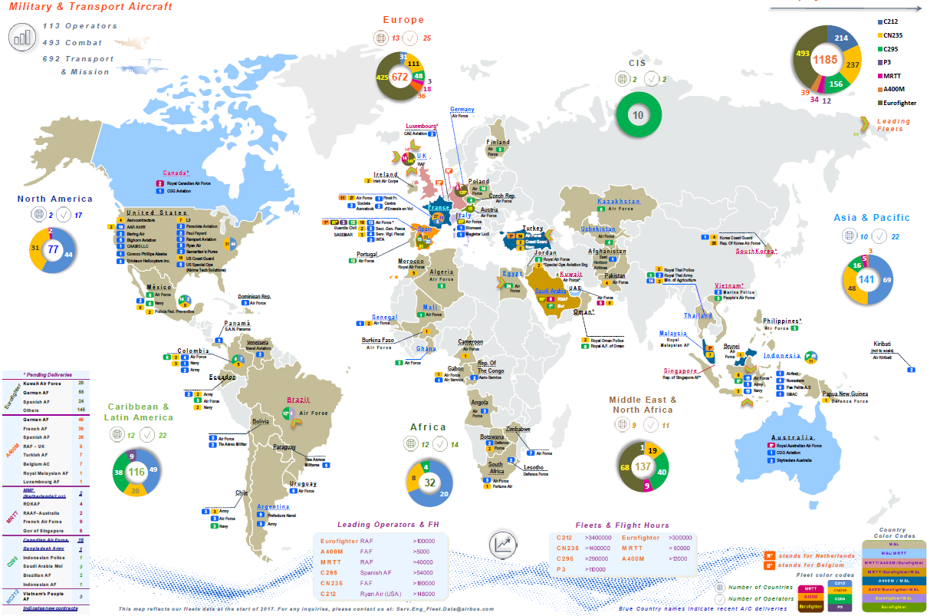
Airbus DS/Military Aircraft portfolio

Slide 4
Airbus DS P&FS organization overview
TA - Military Aircraft
TAD
Deputy
QUALITY
ENGINEERING
SERVICES
PROGRAMMES
OPERATIONS
TADF
Product Safety
TADFX
Product Safety Enhancement
TADFI
Accident/Incident Investigation
TADFO
Safety
Operations
TADFG
Safety
Governance
Manage P&FS process and admni the P&FS tool
Chair P&FS Permanent Committee
Contact point in front of Airw. Authorities & internal dpts
Disseminate lessons learned
SARE (Safety req.) definition and follow-up
Lead Military Aircraft response to Accid/Major incidents investigation
POC fin front of Official Safety Investigation Boards
Relationship with Authorities & Customers
Manage Post-Crisis reaction, ensuring CCC&Go-Team readiness
Manage Customer Safety Programmes
POC for Customers with signed contracts for Safety support
Getafe, Manching & Seville CCCs Maint.
Go Team Training & Equipment
Safety Mgt System implementation
Safety Policy deployment
Product Safety Training & competences
Safety comms and training

Slide 5
Accident/Major Incident Management Process
Accident & Incident Investigation
(PG-144)
Crisis Management Group
To manage the initial hours from the Crisis Control Center:
Support to operator; Collection of initial facts; Authorities contact; Customers Information, Media relations
Your Single Point of Contact / FULL CONFIDENTIALITY
Go Team
Small Group (4-6) to be detached to crash site, for collecting evidences to be used in the further investigation.
Reaction time 4 – 6 hours
Support to the Official Investigation Board.
Accident investigation team
Group of Specialists to perform all investigation activities until full explanation of the events. Identification of findings and safety recommendations. Final report (as technical advisor) released only to affected customer under main principles of mutual trust and full confidentiality.

Slide 6
Acc./Inc. Management Process
Event
ADS – Technical Assistance Center
P&FS:
Decision to open or not CCCs
Decision to launch or not internal notification
Hotline
24h/7days
Open CCCs
24/24 Stby
Crisis management
Centralize & gather the information
Sole authorized source of communication
Top management & internal notification
Decision to trigger or not a Go Team
Assist Go Team
Press communication
Crisis Management Group
Nominate Airbus Lead Investigator (ALI)
Select Go Team
Communication
(Internal/external)
Accident Investigation Committee

Slide 7
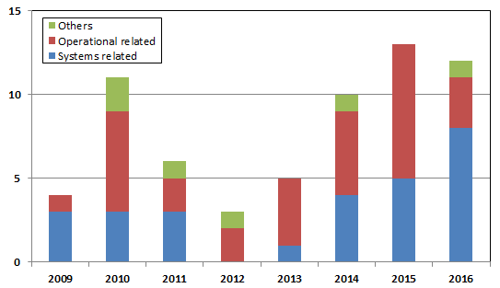
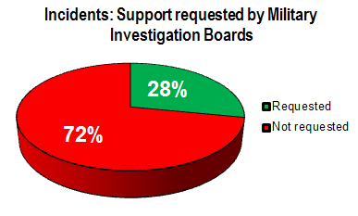
2009-2016: Incident and Accident overview (1/4)
INCIDENTS
Year | Incidents | Systems related | Operational related | Others [Wx, B] | Support requested by InvBoard
2009 | 4 | 3 | 1 | 0 | 0
2010 | 11 | 3 | 6 | 2 | 1
2011 | 6 | 3 | 2 | 1 | 2
2012 | 3 | 0 | 2 | 1 | 3
2013 | 5 | 1 | 4 | 0 | 0
2014 | 10 | 4 | 5 | 1 | 2
2015 | 13 | 5 | 8 | 0 | 4
2016 | 12 | 8 | 3 | 1 | 6
TOTAL | 64 | 27 | 31 | 6 | 18
COUNTRIES WHICH REQUESTED SUPPORT (all Mil Investigation Boards):
2010: Chequia
2011: Equator , Spain
2012: Equator, Spain, UAE
2013: N/A
2014: UK, Spain
2015: France (x2), Jordania, Brasil
2016: Spain, Jordania, Brasil, Saudi Arabia, Australia

Slide 8
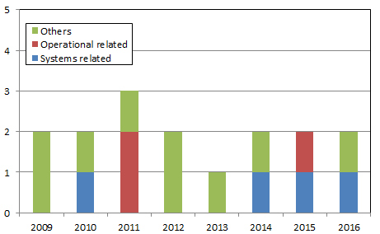
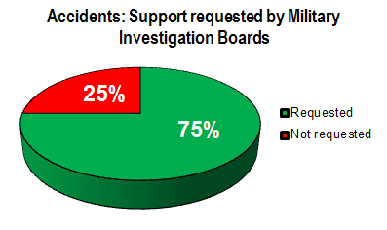
2009-2016: Incident and Accident overview (2/4)
ACCIDENTS
Year | Accidents | Systems related | Operational related | Others [Wx, B] | Support requested by InvBoard
2009 | 2 | 0 | 0 | 2 | 0
2010 | 2 | 1 | 0 | 1 | 2
2011 | 3 | 0 | 2 | 1 | 3
2012 | 2 | 0 | 0 | 2 | 1
2013 | 1 | 0 | 0 | 1 | 0
2014 | 3 | 1 | 0 | 1 | 2
2015 | 2 | 1 | 1 | 0 | 2
2016 | 3 | 1 | 0 | 1 | 2
TOTAL | 16 | 4 | 3 | 9 | 12
COUNTRIES WHICH REQUESTED SUPPORT (all Mil Investigation Boards):
2010: Congo, Spain
2011: Canada, Chile, Indonesia
2012: Argelia
2013: N/A
2014: Germany, Spain
2015: Colombia, Spain
2016: Vietnam, Jordania

Slide 9
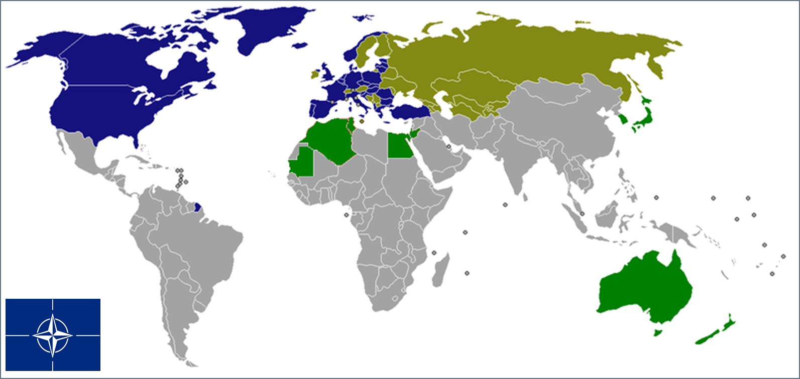
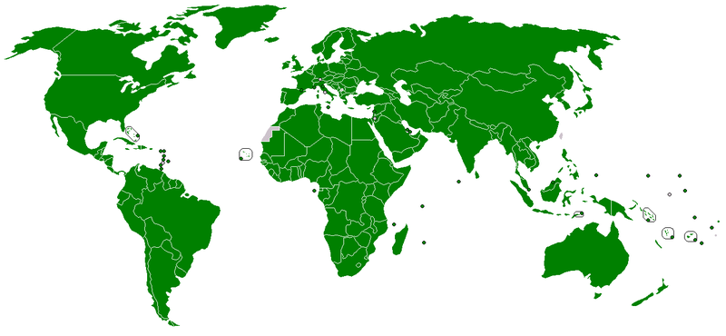
2009-2016: Incident and Accident overview (3/4)
LESSONS LEARNED AND AIRBUS DS EXPERIENCE - 1
ICAO Annex 13 does not apply !!, although in some cases is used as a valid reference.
Something similar established in NATO countries by STANAG 3531, although explicit Manufacturer role is not stated.
ICAO Annex 13 (191 countries).
NATO countries (28) and associated (22+15)

Slide 10
2009-2016: Incident and Accident overview (4/4)
LESSONS learned AND AIRBUS DS EXPERIENCE - 2
As a general rule, Armed Forces are reluctant to accept immediate technical support. When accepted, official request usually comes after days or even weeks since the accident/incident occurrance.
Condidentiallity issues involved: Mission, sensitive geographical location, etc.
Initial intention to keep the investigation ‘in-house’ with own resources.
Unfamiliarity with Airbus DS Accident/Incident management process.
As a consequence of the above, high risk of losing key evidences for detailed investigation (wreckege removal, parts missing, recorded data loss, etc).
With the exception of some nations (UK-MilAAIB, France-BEAD, Spain-CITAAM, etc), not a dedicated Mil Accident/Incident Investigation Organization is established.
Support request for incidents low (28% against 75% for accidents)

Slide 11
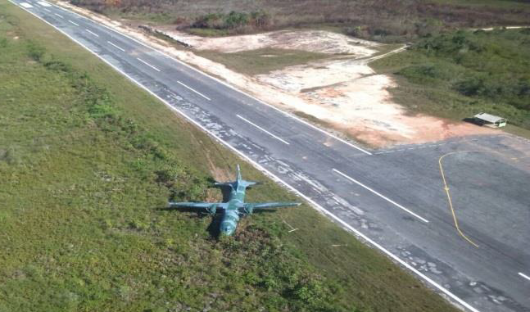
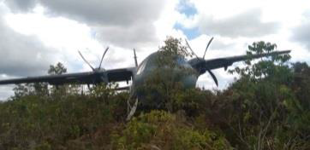
Full involvement as TA: Examples (1/4)
Incident 27 February 16: C-295 Brazilian AF MLG collapse - 1
Incident occurred in Surucucu (Estado de Roraima, Brasil)
Challenging runway, asphalt, poorly maintained: 1080x30 mts, outstanding slope (20º RWY30 along 300 mts to decrease downto 5º at the end).
MLG collapse at touchdown/ No fatalities

Slide 12
Full involvement as TA: Examples (2/4)
Incident 29 March 15: C-295 Brazilian AF RMLG collapse - 2
Historic background: Three (3) similar events
30 January 2007, Palmeras do Javari
13 January 2011 and March 2015, both in Surucucu
Although no GoTeam sent, full Airbus DS involvement as Technical Advisor in front of the FAB since first event.
Operational contributing factors identified: Landings on challenging runways which lead to touchdowns at loads levels beyond the certified limits.
Specific understanding about FAB operations led to foster a MLG improvement to be offered to C295 operators.
A major design change process was approved in 2011. In the mean time, operational recommendations were addressed to help crews to handle challenging landings.
An SB to strengthen the MLG is already avail.

Slide 13
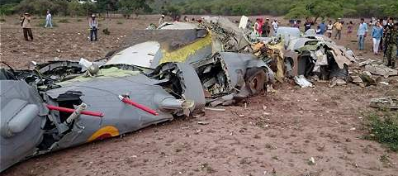
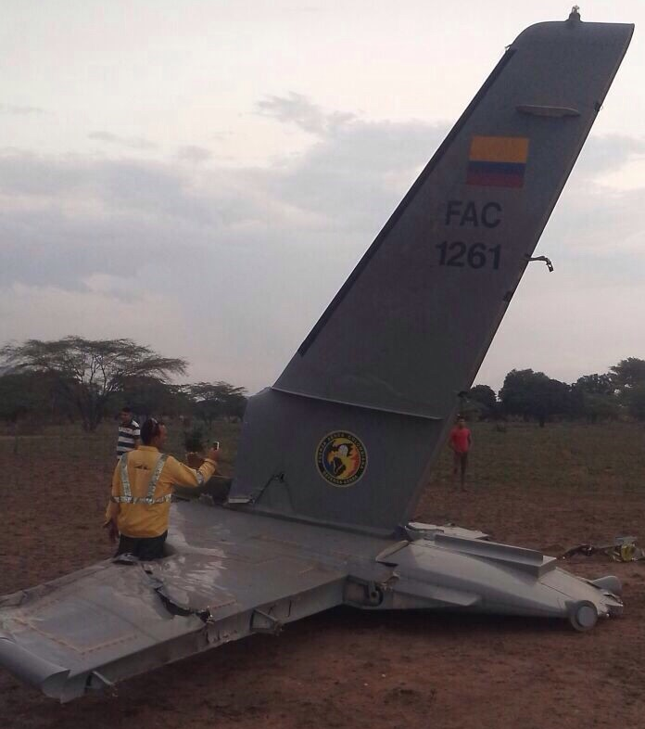
Full involvement as TA: Examples (3/4)
Accident 31 July 15: CN-235 Colombian AF crash - 1
Accident occurred around 20:30 UTC (15:30 LT Colombia)
Poor local weather conditions at the time of the accident
The Colombian Air Force stated that the pilot reported an engine failure prior to the accident
Crash: Departm. del César (NE Colombia), close to Venezuela
Hull loss / 11 fatalities

Slide 14
Full involvement as TA: Examples (4/4)
Accident 31 July 15: CN-235 Colombian AF crash - 2
Airbus DS Accid/Incid Management Process activated on August 1st
Following clearance from FAC, Airbus DS Investigation Team detached to Bogotá from 10th to 20th August (2xP&FS Investigators, 1xStructure +1xPowerplant specialist and 1xInstructor Pilot)
Information available: FDR, CVR, aircraft documentation, wreckage pictures and some parts (engines, props and some panels).
Airbus DS Investigation Report issued on September 4th .
Most probable cause: Inadvertent ice accretion. Contributing factors:
Crew failure to manage WING OVERHEAT emergency procedure while flying in icing conditions.
Sustained flight in icing accretion conditions even with stall warning active.
Safety Improvement: Specific SB to implement an advanced stall warning when flying in icing conditions

Slide 15
Conclusions
Early Manufacturer involment in an Accident/Incident investigation is highly benefitial for both parties: Operator and Manufacturer.
On Operator side, by:
Increasing the Safety of the fleet through the improvement of Procedures and Enhancement of the Product.
Gaining confidence in the Product after an Accident or an Incident.
Having access to advanced investigation resources
On Manufacturer side, by:
Understanding the customer way of operating the Product.
Setting a mutual confidence which leads to enhance the Product.
Confidentiallity and mutual trust are key issues.
Not only accident investigations contribute to enhance the Product. Incidents become accident anticipators if they are not fully understood since the beginning. Manufacturer contribution to this understanding can be also key.

Slide 16
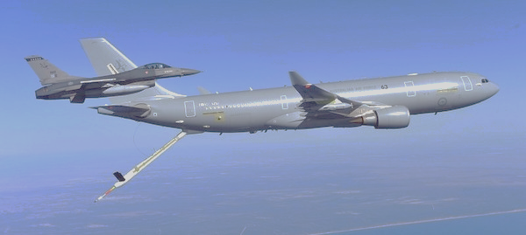
Thank you

